Slide 1


Object-Oriented Programming (OOP) in Python
Presentation by ACHHUTA NAND JHA

Slide 2
Introduction to OOP
Object-Oriented Programming (OOP) is a programming paradigm that uses objects and classes.
Key concepts:
- Classes and Objects
- Inheritance
- Polymorphism
- Encapsulation
- Abstraction

Slide 3
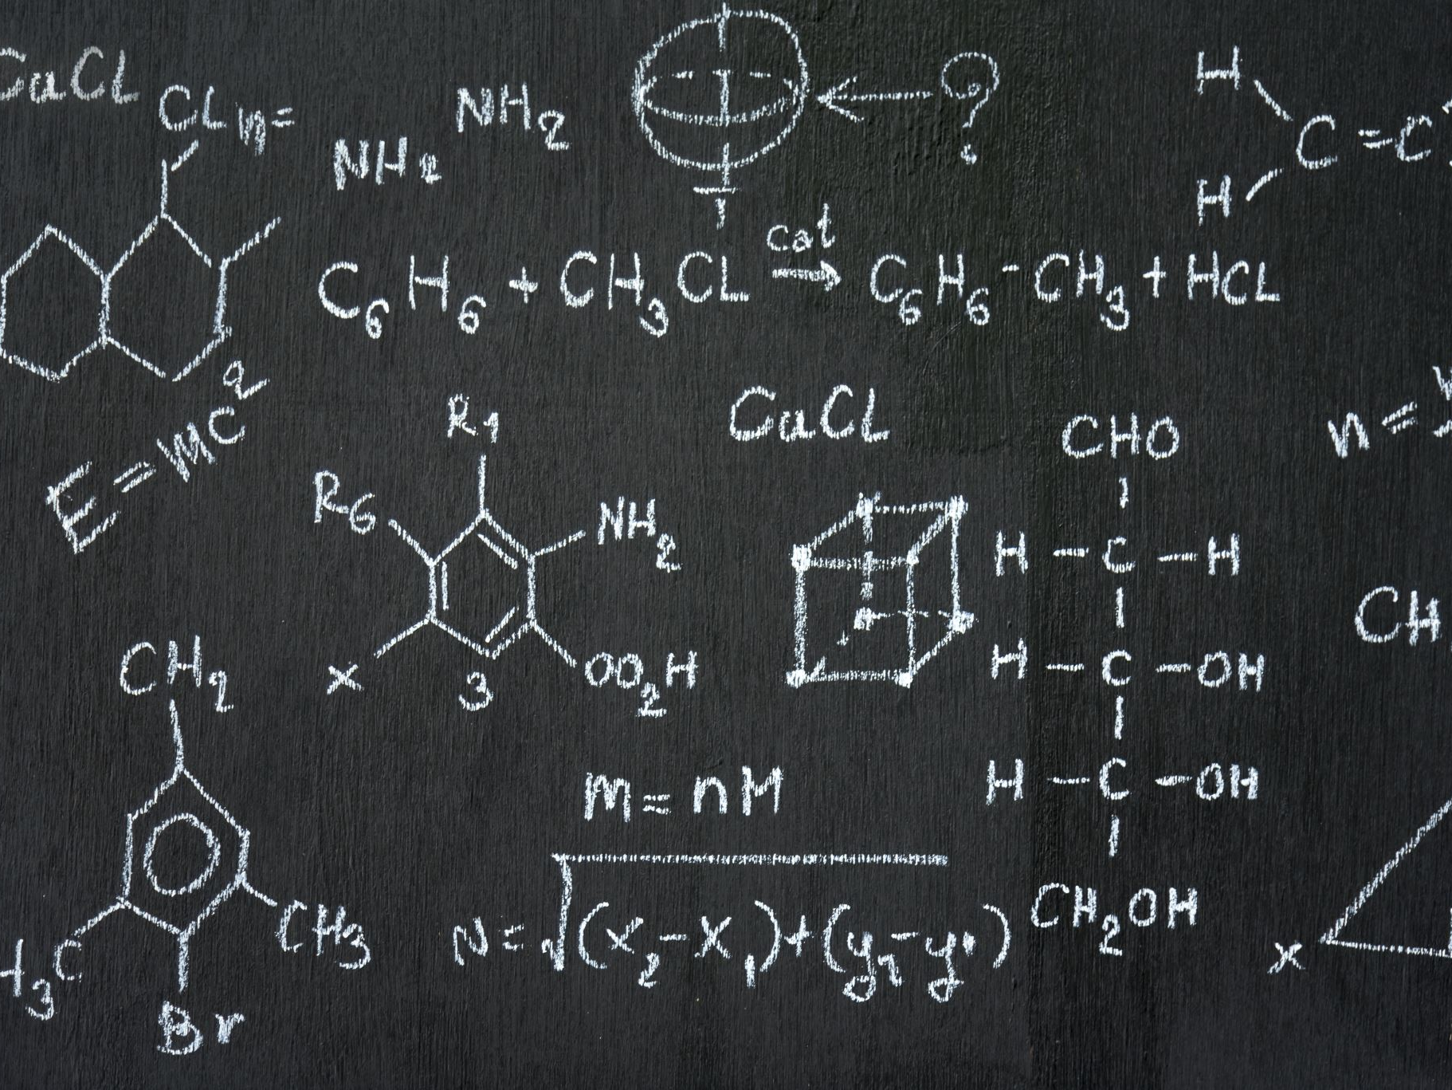
Classes and Objects
Class: A blueprint for creating objects (a particular data structure).
Object: An instance of a class.
Example:
class Dog:
def __init__(self, name, age):
self.name = name
self.age = age
my_dog = Dog('Buddy', 5)

Slide 4
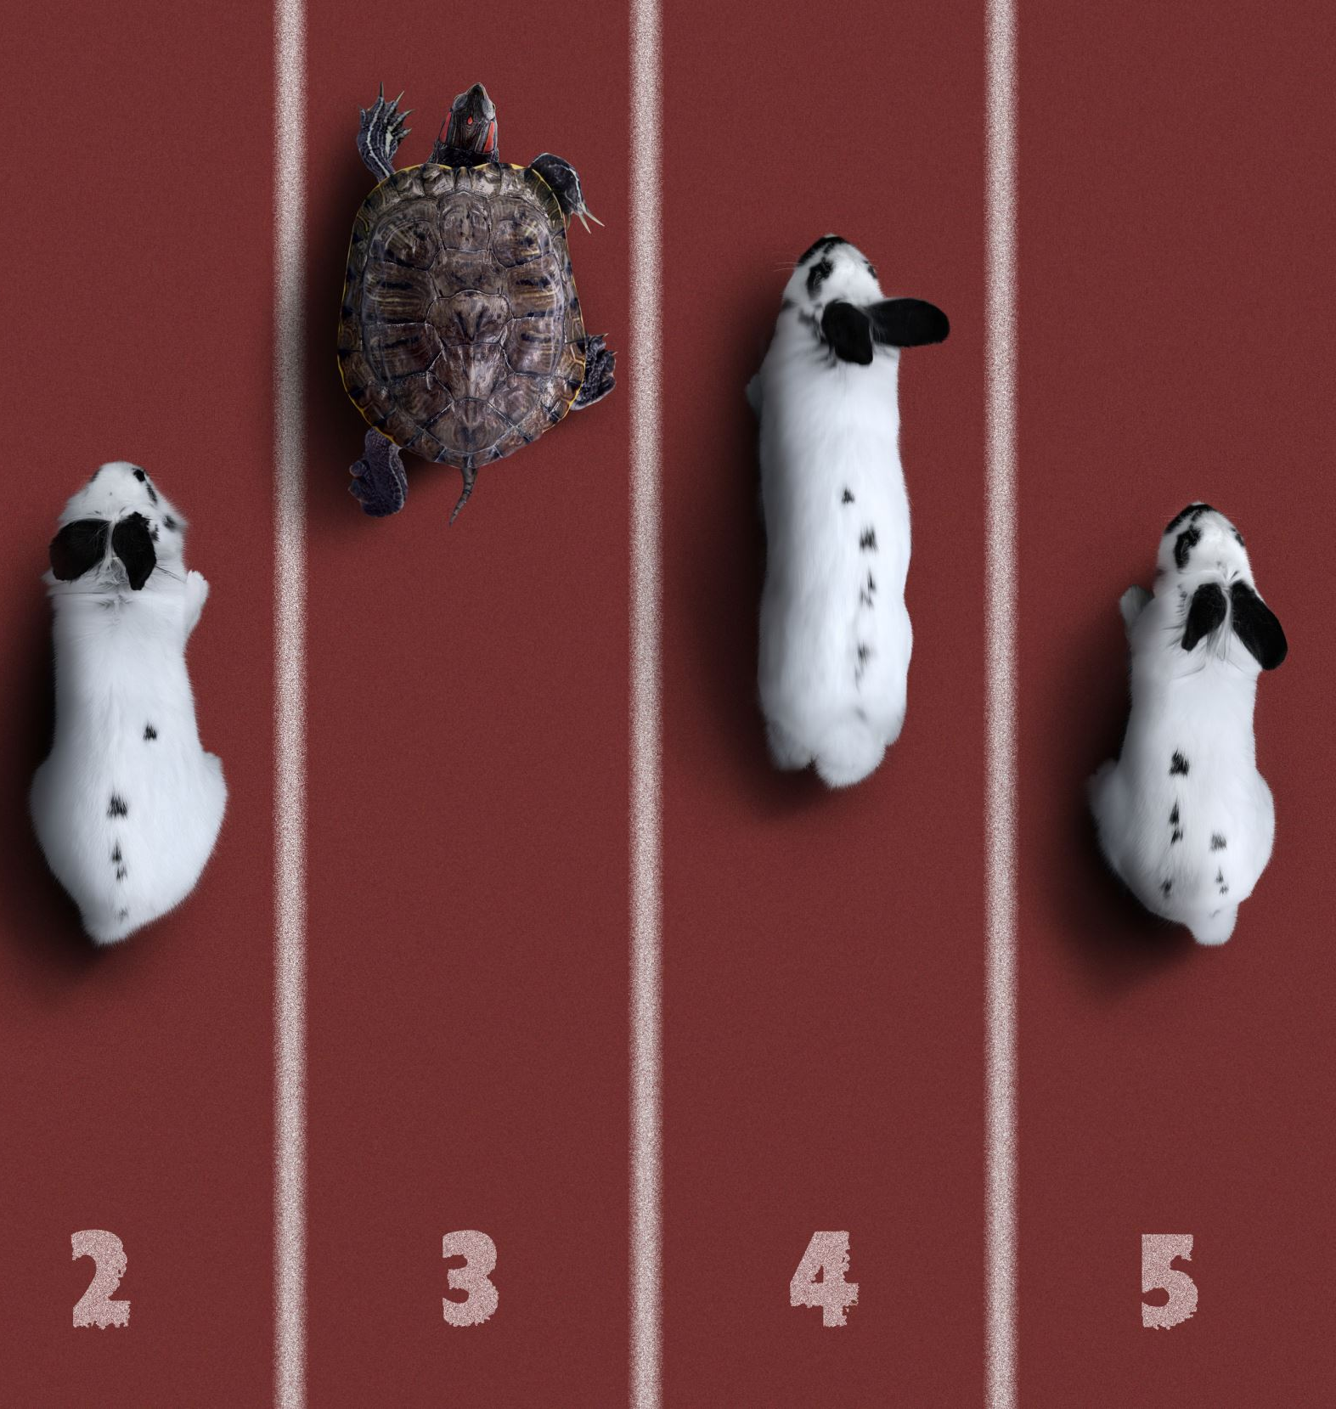
Inheritance
Inheritance: The mechanism of basing a class on another class.
Example:
class Animal:
def __init__(self, name):
self.name = name
class Dog(Animal):
def bark(self):
print('Woof!')

Slide 5

Polymorphism
Polymorphism: The ability to take many forms.
Example:
class Bird:
def sound(self):
print('Chirp')
class Dog:
def sound(self):
print('Bark')
animals = [Bird(), Dog()]
for animal in animals:
animal.sound()

Slide 6

Encapsulation
Encapsulation: The bundling of data with the methods that operate on that data.
Example:
class Car:
def __init__(self):
self.__speed = 0
def set_speed(self, speed):
self.__speed = speed
def get_speed(self):
return self.__speed

Slide 7

Abstraction
Abstraction: Hiding the complex implementation details and showing only the necessary features.
Example:
class Computer:
def start(self):
self.__power_on()
def __power_on(self):
print('Powering on...')

Slide 8

Thank You
Thank you for your attention

